Slide 1
Drone delivery system unit
Day 8
Standards:
8.PS2.3
8PS2.4
8.PS2.5

Slide 2
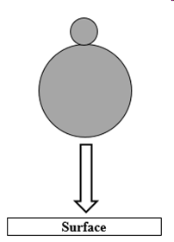
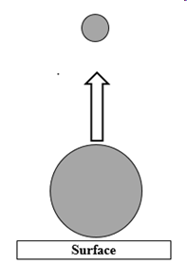

DQ
A science teacher did a demonstration by dropping two balls together at the same time.
The two balls had different volumes and mass. When the larger ball impacted the surface of the floor, the smaller ball was launched upwards at a high rate of speed (see diagrams below).
Diagram 01
Diagram 02
Two-Part Question
Part 1: What caused the smaller ball to accelerate upward at such a high rate?
Part 2: Would this same phenomena occur if you used two identical basketballs?
a. | Part 1: The difference in momentum caused the smaller ball to accelerate. Part 2: Basketballs have a greater mass. Therefore it would have more momentum.
b. | Part 1: The difference in mass and momentum caused the smaller ball to accelerate. Part 2: The basketball would not reach the same velocity that the small ball did.
Standards: 8.PS2.3, 8PS2.4, 8.PS2.5

Slide 3
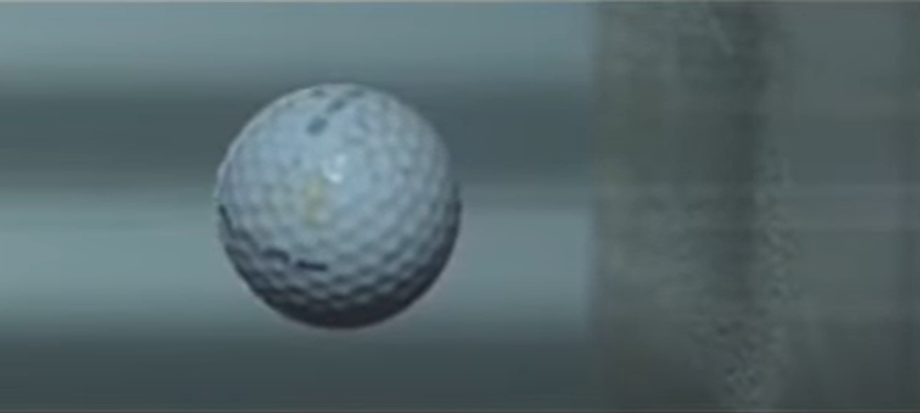
Colliding Objects Changing Shape
1. Today’s investigation will focus on how the shape of objects and their motion change in a
collision.
How will observing collisions help us better understand why the medical supplies are being damaged and to figure out how to prevent the medical supplies from being damaged?
What sort of things would we want to observe more closely in a collision that may or may not result in damage?
2. Watch this video of a golf ball hitting at 154 mph:
Standards: 8.PS2.3, 8PS2.4, 8.PS2.5

Slide 4
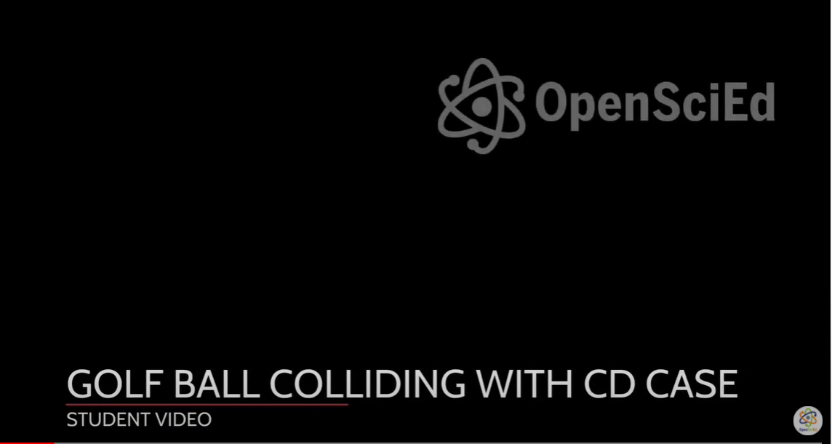
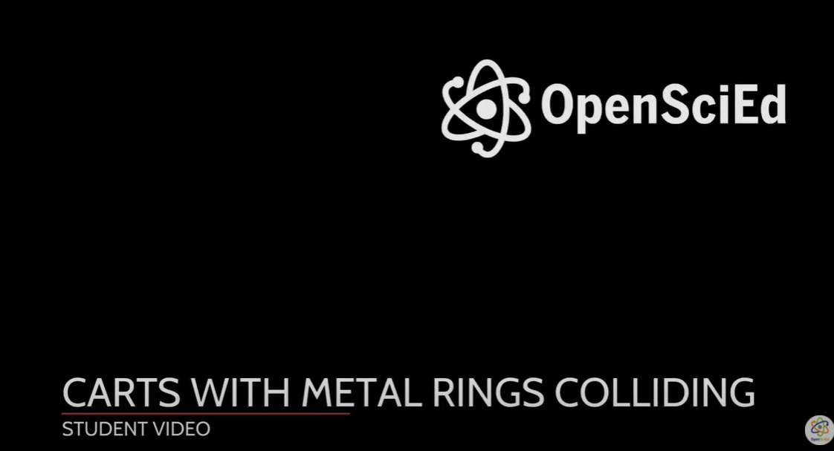
3. Watch the following two videos* and answer the question: What might be causing the changes in motion and changes in the shape of colliding objects?
Standards: 8.PS2.3, 8PS2.4, 8.PS2.5

Slide 5
Colliding Objects Changing Shape
1. What might be causing the changes in motion and changes in the shape of colliding objects?
________________________________________________________________________________________________________________________________________________________________________
2. How could we investigate if ANY amount of force would cause ANY solid object to start bending or change shape?
____________________________________________________________________________________________________________________________________________________________________________________________________________________________________________________________
3. Material your group will be testing: _______________________________________________________
Standards: 8.PS2.3, 8PS2.4, 8.PS2.5

Slide 6
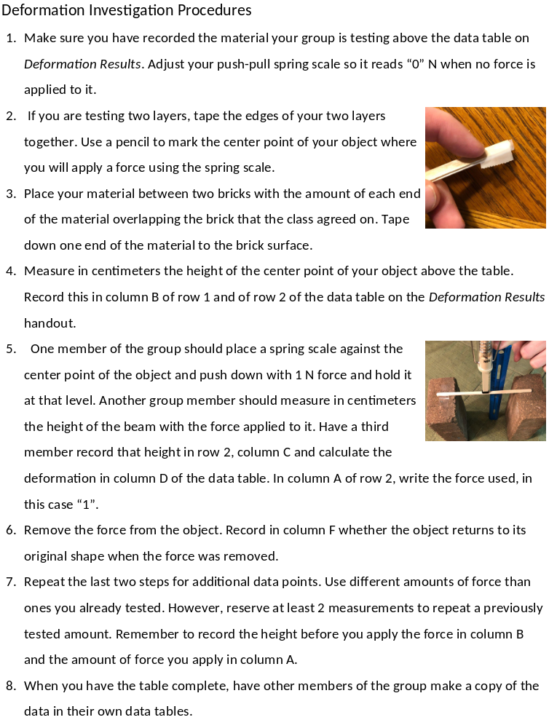
4. Using the Deformation Investigation Procedures page, plan an investigation with independent, dependent, and controlled variables to answer the question: How much do you have to push on any object to get it to deform (temporarily vs permanently)?
• Independent variable: ___________________________________________
• Dependent variable: _________________________________________
• Controlled variables: ___________________________________________
Standards: 8.PS2.3, 8PS2.4, 8.PS2.5

Slide 7
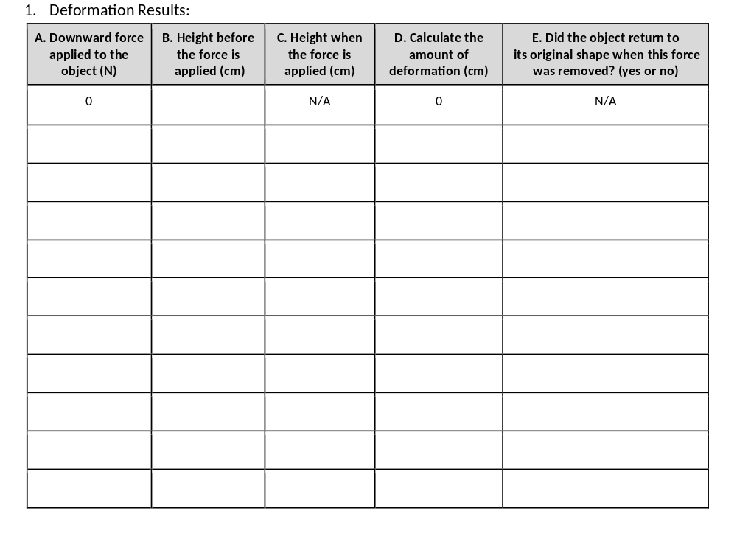
Standards: 8.PS2.3, 8PS2.4, 8.PS2.5

Slide 8
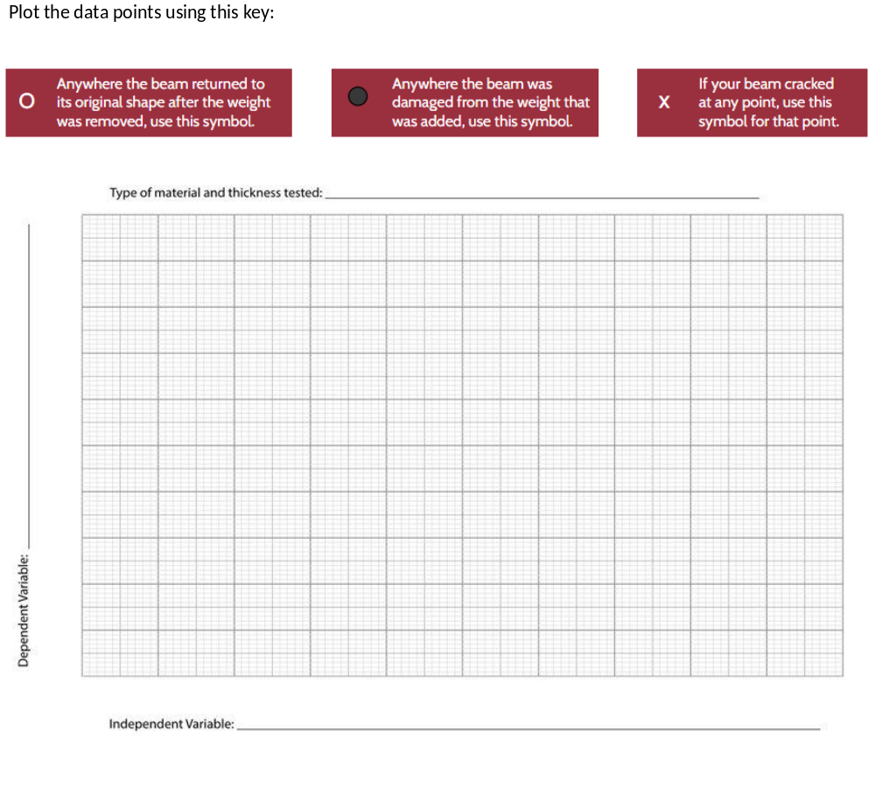
Standards: 8.PS2.3, 8PS2.4, 8.PS2.5

Slide 9
How is this investigation related to Newton’s 3rd Law and the anchoring phenomenon?
Standards: 8.PS2.3, 8PS2.4, 8.PS2.5

Slide 10
Air Resistance/Drag
Procedures:
Launch the car without a notecard-sail attached down the track using the launcher. Reposition the fan in order to create wind conditions as follows:
No wind (fan off)
Headwind (fan in front of car)
Tailwind (fan behind car)
Try each of these conditions using the same amount of launcher force each time.
Notice how far the car travels for each trial. Record your observations.
Locate the car with a notecard-sail attached to the front of the car with tape.
Hold the car with the sail stationary with your hand and observe what happens to the shape of the sail when there is a fan blowing wind toward the front of the car vs. toward the back of the car.
Repeat steps 1 through 3 for conditions a, b, and c using the car with a notecard-sail attached. Be sure to keep constant the launcher force you used when the car had no sail.
Standards: 8.PS2.3, 8PS2.4, 8.PS2.5

Slide 11
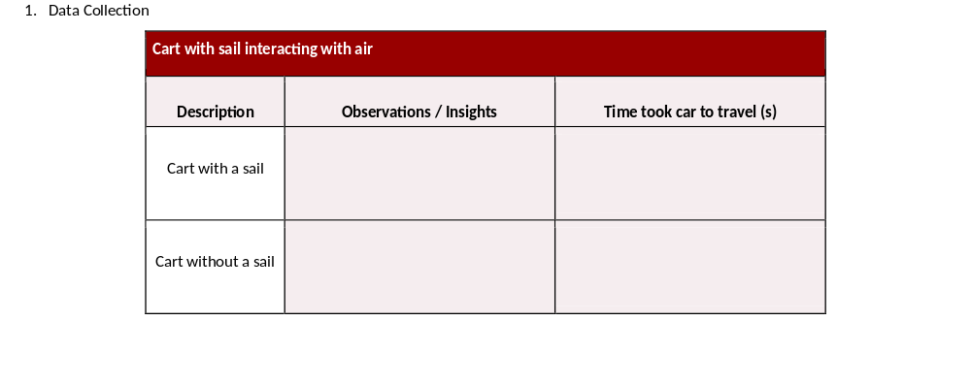
Standards: 8.PS2.3, 8PS2.4, 8.PS2.5

Slide 12
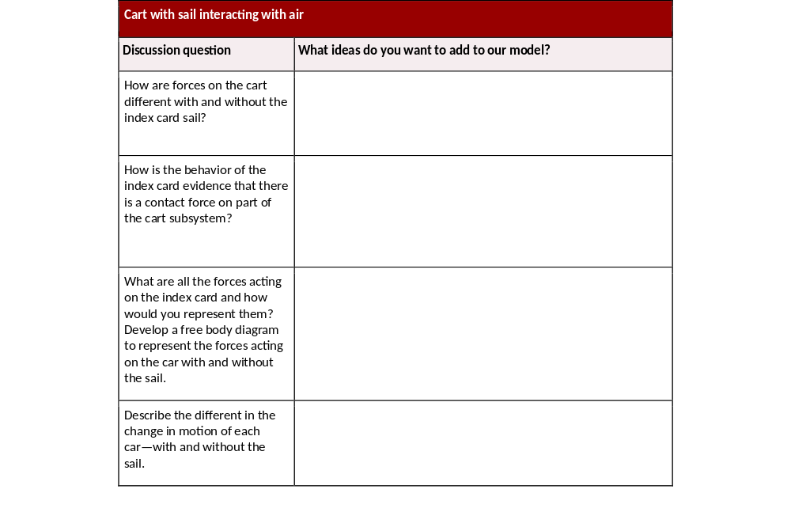
Standards: 8.PS2.3, 8PS2.4, 8.PS2.5

Slide 13
Revise your initial model

Slide 14
Exit Ticket:
What is the formula for Force according to Newton’s 2nd Law?

